Slide 1
Enhancing Reports Using the Data Model: Data Sources
Notes:
Delete this text before publication.
Final Edit Checklist
Delete the dashed red lines from the Master slide.
Save this file in normal slide view. Do not save with any of the Master views open.
Verify that the Help tree navigation paths in the Notes Layout are correct.
Verify that you have deleted any extra blank lines at the end of each of the notes layout pages.
Verify that you have deleted all instructional template text from the notes pages.
Schedule: Timing Topic
<xx> minutes Lecture
<xx> minutes Practice
<xx> minutes Total

Slide 2
Objectives
After completing this lesson, you should be able to do the following:
  Describe the various data source types
  Create reports using pluggable data sources
  Create supplemental rows of data by adding queries
  Reuse PL/SQL code to create a REF cursor
  Link data from multiple data sources using a data link

Slide 3
Data Source Types
  Access data from a variety of sources:
  SQL-based
  Non SQL-based
  OLAP
  JDBC
  Metadata
  BC4J

Slide 4




Pluggable Data Sources
Your
data
source
Express
XML
JDBC
Text
files
Oracle9i
Reports
Client
Oracle9i

Slide 5
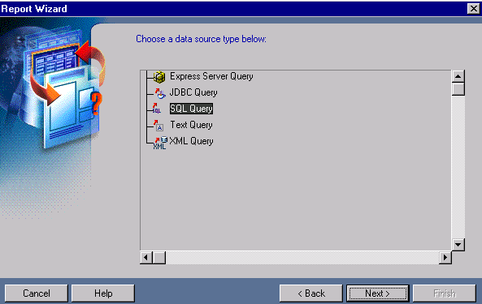
Out-of-the-Box Options

Slide 6
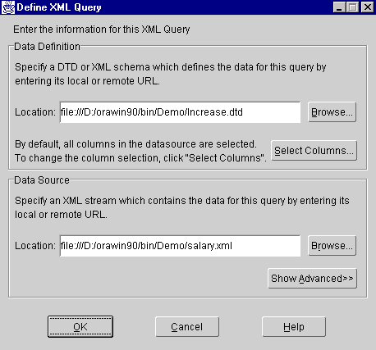
Using XML as a Data Source

Slide 7
Example: XML Data Stream
<TABLE>
<ROW>
<EMPID>100</EMPID>
<BONUS>2000</BONUS>
<PERINC>8</PERINC>
</ROW>
<ROW>
<EMPID>101</EMPID>
<BONUS>1000</BONUS>
<PERINC>5</PERINC>
</ROW>
.
.
.

Slide 8
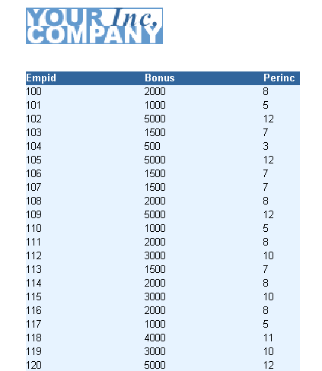
XML Report

Slide 9

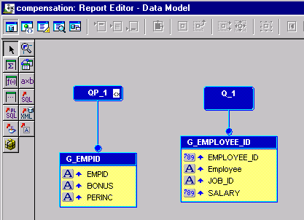
Adding New Data
1
4
2
5
3
6

Slide 10
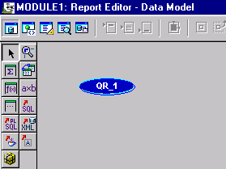
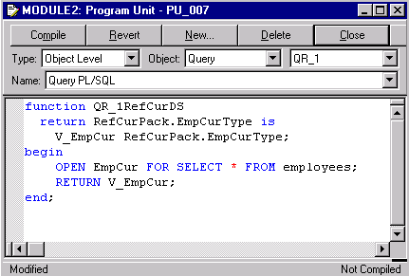
REF Cursor Queries

Slide 11
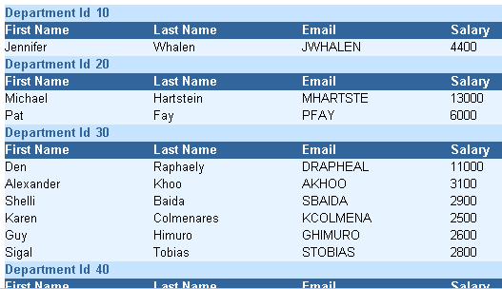
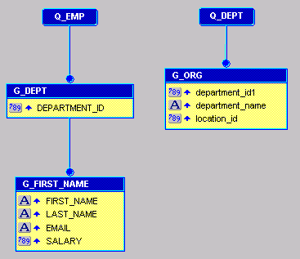
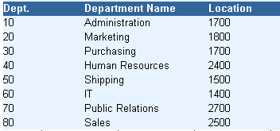
Viewing Output from Multiple Query Reports

Slide 12
Using Data Links
Equijoin
DEPARTMENTS
Department_Id
90
100
Department_Name
Executive
Finance
EMPLOYEES
Last_Name
DeHaan
Greenberg
Faviet
Department_Id
90
100
100
Department_Id =
Department_Id

Slide 13
Using Data Links
  Compound join:
    Multicolumn primary or foreign key
    Define multiple equijoins
  Nonequijoin:
    Primary key value between two other values
    Create two links:
  employees.salary >= job_grades.lowest_sal
  employees.salary <= job_grades.highest_sal

Slide 14
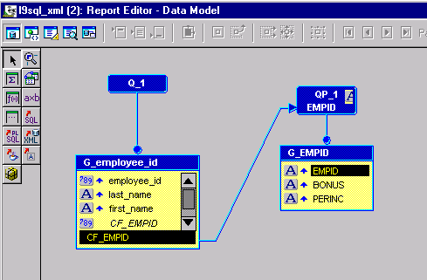
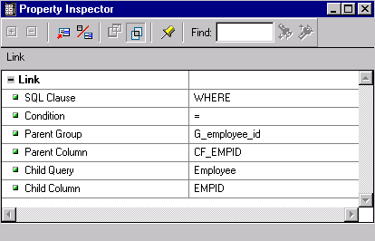
Creating a Column-to-Column Link

Slide 15
Other Data Link Methods
Other methods of forming a link:
  Manual: Using a WHERE clause to form the link (SQL queries + column objects)
  Manual: Using parameters to form the link (REF cursor queries)
  Automatic: Using primary/foreign key constraints to form the link (SQL queries)

Slide 16
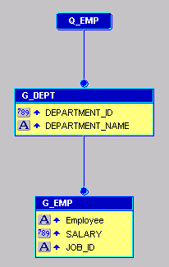
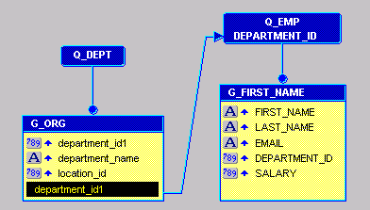
Efficiency Implication of Multiple- or Single-Query Hierarchy
  Outer joins
  Data ratio
  Multitier environment

Slide 17
Summary
  In this lesson, you should have learned how to:
  Publish data from any source using the Pluggable Data Source feature
  Add additional queries using the Data Wizard
  Publish a report with data returned from a REF cursor query
  Create a relationship between data in different queries using a data link
  Design the data model to be most efficient

Slide 18
Practice 9 Overview
  Creating a second query in an existing report
  Creating a data link
  Creating a report using a pluggable data source
  Creating a report containing a REF cursor query

